Slide 1
Taming the 800 Pound Gorilla: The Rise and Decline of NTP DDoS Attacks
Jakub (Jake) Czyz, University of Michigan
Michael Kallitsis, Merit Network, Inc.
Manaf Gharaibeh, Colorado State University
Christos Papadopoulos, Colorado State University
Michael Bailey, University of Michigan and University of Illinois
Manish Karir, Merit Network, Inc.
Internet Measurement Conference
Vancouver, BC, Canada
November 5-7, 2014
Notes:
Hi everyone. [SMILE], I’m Jake Czyz (if not introduced), and I’m here to present work on NTP DDoS, which was done with collaborators at Michigan, Merit Network, Colorado State, and the University of Illinois.
Since it’s right after lunch, I will try to talk loud and fast, but, I hope the material itself also helps to keep you awake. ☺

Slide 2
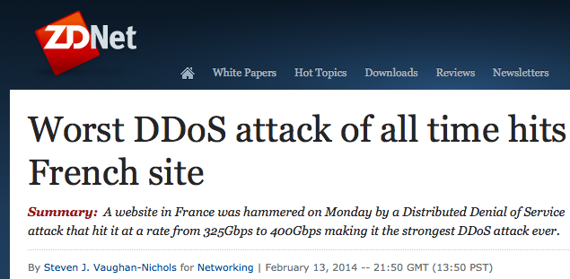
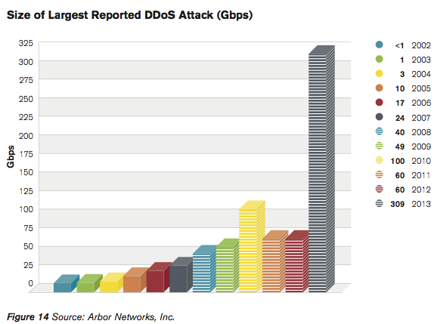
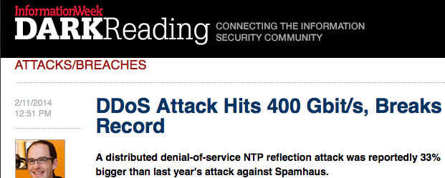
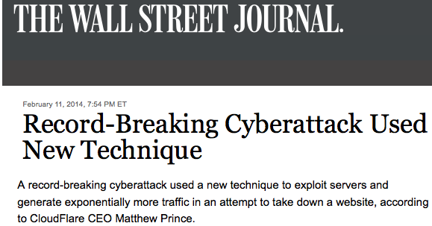
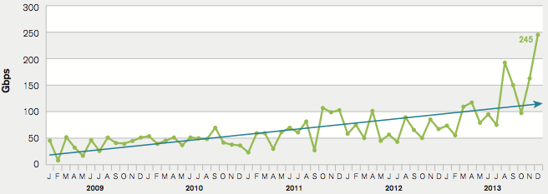
The DDoS “Hockey Stick Era”
Notes:
In the second week of February the tech news bubble was quite abuzz regarding a DDoS attack on the French hosting provider OVH. [PAUSE]
Now, DDoS attacks have been around for years, of course, but this one caught people’s eye for two reasons: First, [CLICK] it was the largest ever reported--clocking in at around 400 gigabits per second.
Secondly, this attack included a technique that had been nearly unheard of just several months prior, but which had started to gain momentum starting in December.
Basically, by taking advantage of network time protocol diagnostic features, miscreants were able to amplify their attack traffic to an extent that the world had not previously seen. Someone even dubbed it the hockey stick era of DDoS.
(another early ref: http://www.symantec.com/connect/blogs/hackers-spend-christmas-break-launching-large-scale-ntp-reflection-attacks)

Slide 3
Agenda & Overview
Introduce NTP Reflected/Amplified DDoS
Summarize Key Measurements
Goal: to understand the attack:
Mechanics, size and evolution, impacts, enablers, victims, attacker clues and motivations, and mitigation progress
Six datasets: global and local perspectives
Global DDoS attack counts/types: Nov.’13 – Apr. ’14
Global NTP traffic: Nov.’13 – Apr. ’14
Darknet (IPv4, ~/8): Sep. ‘13 – Apr. ‘14
Two Local ISP/campus netflow : Dec. ‘13 – Feb. ‘14
IPv4-wide NTP monlist & version probes: Jan. ‘14 – Apr. ‘14
A strange discovery
Conclude
Notes:
This escalation of DDoS power caught our attention and we wanted to learn the story behind these attacks.
How did they work?
Who and what was enabling them?
what impact were they having globally and how did this affect innocent bystanders in these attacks?
What about victims? Who were attackers targeting, when, and with how much traffic?
Could we glean any clues about attacker motivation and M.O.? [PAUSE]
Finally, how has the operator community responded and is the NTP threat subsiding?
[CLICK]
To help answer these questions, we analyzed six datasets that give us both a global and local perspective on this phenomenon.
[CLICK]
So, the agenda for the remainder of the talk is straightforward. I’ll first introduce the mechanics of this attack and then I’ll delve into the datasets we analyzed and how they answer these questions.
I’ll also talk a little bit about the remediation that the community put in place and its impact, after which I’ll wrap up.
Now, there are a lot of interesting details that we found and describe in the paper but which I have to leave out for lack of time, but I really encourage you to have a look at it if you’re at all interested in this domain.

Slide 4
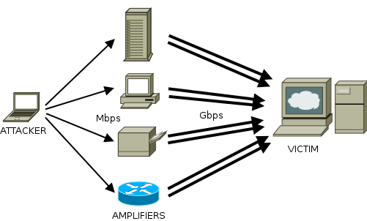

Reflected & Amplified DDoS Attacks
Volumetric attacks that seek to overwhelm victim with traffic
Often rely on properties of several UDP-based protocols:
- Spoofability, broad deployment, and large responses to small requests
Best Practice:
BCP 38
Notes:
Okay, so let’s start with a very quick visual primer on the mechanics of these attacks. First of all, keep in mind that, generally speaking, volumetric DDoS attacks simply aim to overwhelm a victim with traffic.
But, since attackers are usually individuals whose ability to create lots of traffic may be limited, they take advantage of the reflection and amplification properties of several UDP-based protocols.
Here’s what happens. [CLICK].
An attacker sends small typically UDP requests, such as DNS queries, to each of some set of intermediate hosts that can act as amplifiers.
And, thanks to the attackers living on networks that [CLICK] do not follow best practices and allow spoofed traffic to leave them, the attackers can craft their request packets to have source addresses that actually belong to their VICTIM.
The amplifiers, upon getting these requests, simply do what they normally do and reply to them, sending their large replies to the victim. [CLICK]

Slide 5
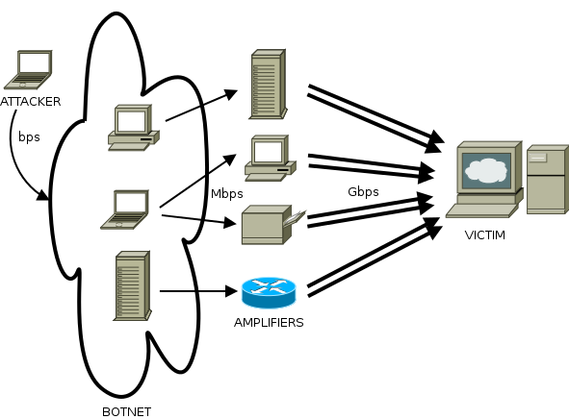

Reflected & Amplified DDoS Attacks
Notes:
And of course, thanks to the magic of botnets, a more advanced attacker that controls (or can cheaply rent) a botnet can, at will, basically generate massive amounts of traffic via a tiny botnet command and control channel.

Slide 6
NTP DDoS Attack Mechanics
Network Time Protocol: for synchronizing system clocks
Widely deployed on servers, workstations, and network gear
Normal Use:
small client and small server packets (symmetric)
typically one exchange every 1 to 12 minutes
NTP protocol normal modes (mode 3 or 4)
Attacks:
small requests, large responses (asymmetric)
typically many times per second
NTP protocol special diagnostic modes (6 or 7); most
egregiously: “monlist” command (out of several):
Request: 1pkt, ~100B
Response: up to 40pkt, ~20,000B; ~200x amplification
Notes:
OK. So, those were amplified and reflected DDoS attacks in general, and now let’s talk about NTP in particular.
NTP’s an old protocol, standardized in 1985, and used for synchronizing machine clock time. It runs on server and client machines as well as on networking gear and on other Internet hosts. It is widely deployed.
In normal operation [CLICK], clients and servers exchange a symmetric amount of traffic, doing so just once every one to a dozen minutes, and using a normal NTP protocol mode 3 or 4 exchange. However, when used in attacks [CLICK], the profile looks much different, with attackers leveraging one of several special diagnostic features of the protocol to amplify small requests into large responses. Most notably, they use the monlist command which, when sent a single small request packet of under 100 bytes, replies with the list of up to the last 600 clients that used that NTP server along with some details about each client. Together, that response data can total around 22 kilobytes across 40 packets. A 200x bandwidth amplification factor.

Slide 7
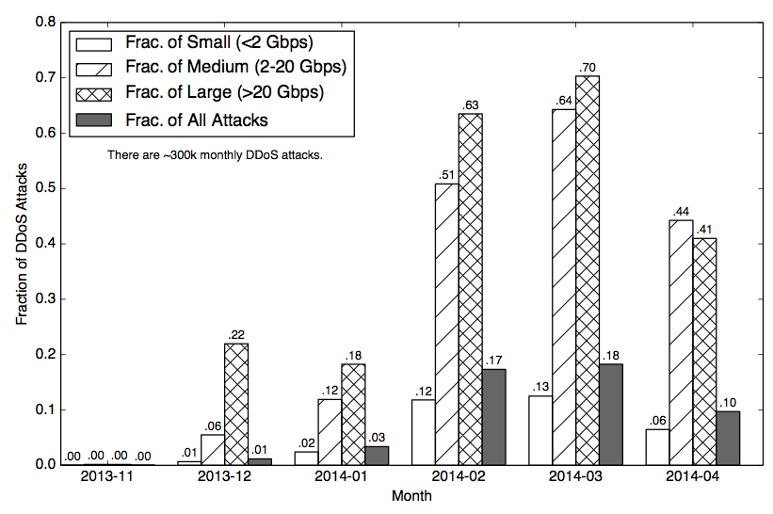
NTP Attacks
Majority of Large Attacks
Negligible Fraction of all DDoS
Notes:
Now, those press releases aside, we were first interested in understanding just how many DDoS attacks were actually using the NTP vector.
To study this, we obtained six months of DDoS statistics from Arbor Networks. Arbor Networks is a DDoS mitigation and network analytics vendor that has network monitoring boxes deployed at around 300 mostly large network operators worldwide. Their boxes monitor an estimated third to a half of all Interdomain traffic. They detect and report both traffic statistics as well as attack counts and categories.
[CLICK] In this graph, we show the fraction of small, medium, large, and all DDoS attacks that used the NTP protocol in each of the six months starting in November. As we can see, last November, the fraction of DDoS attacks using NTP was negligible. [CLICK]
However, [CLICK] by March NTP dominated all medium and large attacks, which includes those between 2 and 20 gigabits. Then, starting in April we begin to see a decline.
I don’t have time to show it here, but in the paper we also looked at global NTP traffic, and found that NTP balooned by three orders of magnitude over the course of this time period, peaking at a full 1 percent of all Internet traffic in early February (five times higher than even DNS traffic), and then, like attacks, declining toward April.
Overall, these numbers show a massive surge in NTP attacks and a large impact on both the DDoS landscape and Internet traffic in general.

Slide 8
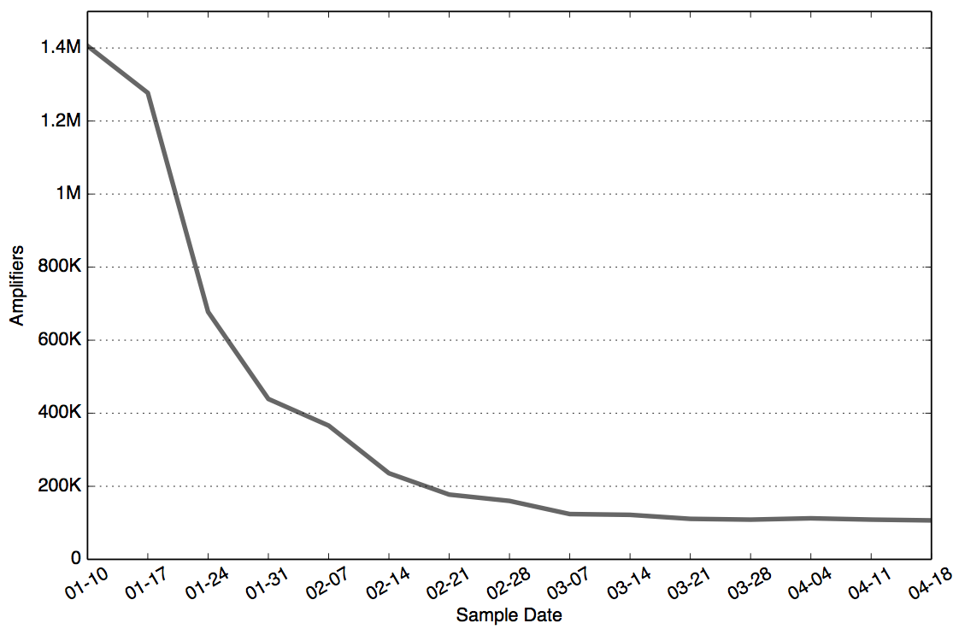
NTP monlist Amplifier Population
See also: Kührer et al. 2014@USENIX
Drop: 93%
Notes:
Alright, well, even at a big amplification rate, the number of amplifiers needed to generate so much global traffic is probably large, and we wanted to see just how large.
The OpenNTPProject.org led by Jared Mauch, has, since early January, been running a weekly scan of the entire IPv4 address space, sending every IP an NTP monlist request, and recording all response packets. The project shared with us the packet captures of the responses to their scans.
[CLICK] In this chart, we show the unique number of monlist amplifier Ips over time. These are Ips that respond to the monlist query with more bytes than they are sent.
Over the course of the first eight or ten weeks of data we see a dramatic reduction of amps from 1.4 Million in early January to around 100 thousand in March; a 93% reduction
These reductions are partly due to the remediation of amplifiers and some mitigation efforts such as filtering at borders, In the paper we show how this drop compares to a couple other threats, showing that it was very quick indeed.
After our paper first went in, there was some work published in USENIX by Marc Khurer and colleagues [CLICK] where the authors report on an effort to notify operators with NTP monlist hosts, and perhaps this effort helps explain the swift remediation.
Still, a 100K amplifiers remained at the end of our study, and that number has only gone down a little bit since. I looked at the data several months out after mid April and saw the trend continue.

Slide 9
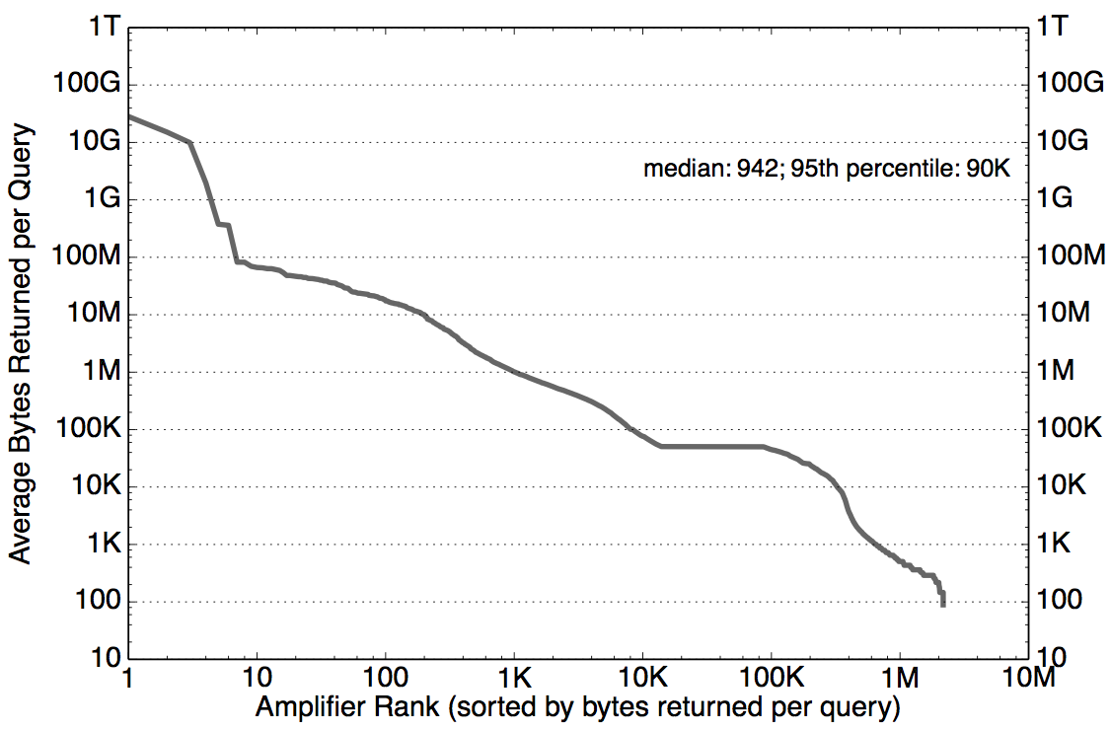
Amplifier Power
Handful of “Mega Amplifiers”: Top 20 avg.: > 60,000,000x
Pool of 1k: > 10,000x
Pool of ~100k: 200x
Median: 10x
Notes:
So, how much damage are all these NTP amplifiers able to do – How much can they amplify attack traffic? To answer this, we analyzed the response packets for each unique amplifier seen in the 15 weekly scans. [CLICK]
Now, this graph shows, for each unique amplifier, the averaged bytes returned across all successful queries. We’ve sorted the amplifiers by bytes returned, and both axes are log scale.
So, let’s start by looking at the majority of amplifiers, which are on the right half of this plot.
The first finding here is that most NTP monlist queries that succeed provide at least a modest amount of amplification, since a minimum query packet is a bit under 100 bytes on the wire, the median monlist server with a 1K response, produced around a 10x amplification factor.
OK, Now, the maximum number of entries that a monlist table returns should yield around 20 kilobytes of response packets. Indeed, 99% of the NTP amplifiers responding, did so with less than 50K bytes on the wire, and there was a pool of around 100k [CLICK] that responded with the full list of 600 entries at the time they were probed, which gives us an amplification factor of about 200x.
Surprisingly, when we look at the left side of this graph [CLICK], we see that there’s a small pool of about 1000 amps that each respond, on average, with more than a megabyte of data, which is an amplification factor of over 10 thousand. Several amplifiers actually replied with tens of gigabytes of data [CLICK], a mind-boggling amount of response traffic for a single tiny query packet!!
In follow up studies we saw that some of these amplifiers responded for hours or days after an initial single packet query. Now, we haven’t really solved the mystery of these mega amplifiers, but we have some clues, which I’ll get back to in a few minutes.

Slide 10
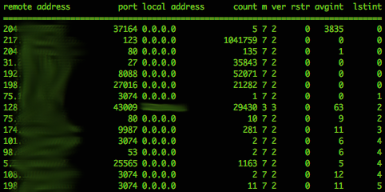
The monlist Table
Notes:
One key piece that made the NTP DDoS attacks so powerful is the monlist command, which, again, returns details for up to the last 600 server clients.
[CLICK] Here’s an example of an actual table. As you can see, it includes the IP address of each client, the port number, and some other interesting things like the count of requests received, the NTP mode, and the timing of connections.
Well, it turns out that this aspect of the NTP DDoS is very useful to us for actually *studying* the attacks. The reason is that when NTP amplifiers are being used for attacks, what they believe to be legitimate clients communicating with them are really attackers, but the attackers use the victims’ IPs to query the amplifier. So, the list of previous clients that monlist returns is essentially a hit list of all of the IPs that were victimized by attackers via the given NTP amplifier.
Via some simple heuristics, we can deduce with high confidence that a given listed IP was the victim of a flood of traffic from the given amplifier.
So, by reassembling the response packets from each of the amplifiers seen over the fifteen weeks of scan data into these monlist tables, we were able to build a picture of what the NTP DDoS attack landscape looked like from the perspective of over a million NTP amplifiers used in the NTP attacks.

Slide 11
Attack Time Series
Notes:
This allowed us to, for example, calculate and graph the time series of attacks that used these amplifiers. Interestingly, we find that they peaked in mid-February at the time of the reported large attack on the French hosting provider OVH.

Slide 12
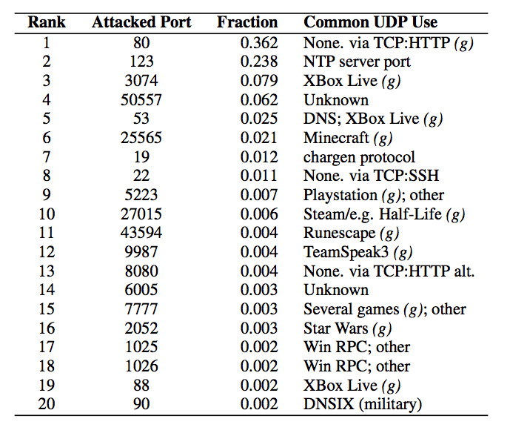
Top Attacked Ports
10+ of Top-20 Ports are
Gaming-related
Notes:
Also, by aggregating the attacked ports, we were able to get a sense of what applications the attackers may have been most interested in disrupting. [CLICK]
This chart shows the top twenty ports that appeared to be targeted either deliberately or due to the scripts/tools that attackers were using.
We see that 36% of the NTP attacks were directed toward UDP port 80, perhaps because they wanted to attack web servers and lacked clue or because they thought somehow filters or firewalls would allow more of these UDP port 80 packets through.
Remember that these types of DDoS attacks are volumetric, and so they mainly intend to eat up bandwidth on the target in general, not necessarily to disrupt specific aps.
[CLICK] Still, we note that 10 of the top 20 ports were associated with games or gaming systems. The likely gaming-related targets were at least 15% of seen attacks.
This is congruent with industry and press reports that claim that much DDoS activity occurs between competing gamers either for revenge, gaming advantage, or financial gain, as many game tournaments involve money.

Slide 13
Mega Amplifiers in Monlist Table
IP | … | Count | Inter-arrival
ONP Scanner IP | … | 1 | 0
Other IP X | … | 123456 | 0
IP | … | Count | Inter-arrival
ONP Scanner IP | … | 2 | 0
Other IP X | … | 123456 | 0
…
…
IP | … | Count | Inter-arrival
ONP Scanner IP | … | 204242 | 0
Other IP X | … | 123456 | 0
Notes:
Alright, so in addition to the time series of attacks and who was being victimized on what port, another thing that the monlist tables help us understand at least a little better is the Mega amplifiers.
[CLICK] When we examined the tables coming from mega amps and looked for patterns, we found that, in most cases, the response tables indicated an incrementing count field for queries from our scanner, which was the most recent client listed and with an inter-arrival time of 0. In other words, the server thought that we were re-sending our probe packet and, thus, was continuing to reply, incrementing our query count entry in its table.
Perhaps, we thought, some sort of routing or switching loop near the amplifier was causing our query packet to be presented multiple times to the amplifier. However, later experiments showed that some of these amplifiers would sent traffic for hours or days after the original query packet. Some mega amps behaved this way multiple weeks in a row, each time responding for hours or days to a single-packet query. So the problem did not appear to be transient.

Slide 14
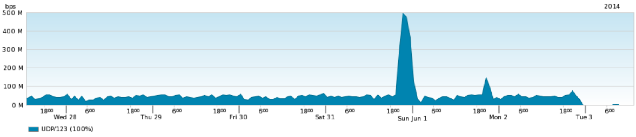
Mega Amplifiers Follow-Up
Mega2 : ~400Mbps for 6 hrs.
Not exactly hoisted by our own petard, but …
Mega1: 50Mbps for 7 days!
Top twenty amplifiers in original 15-week study:
Rank | Bytes Per Query | Country
1 | 45,449,582,522 | JP
2 | 28,278,811,947 | JP
3 | 15,071,819,517 | JP
4 | 9,925,296,893 | JP
5 | 1,970,253,817 | JP
6 | 376,813,551 | JP
7 | 360,527,290 | JP
8 | 82,340,368 | KR
9 | 82,020,576 | KR
10 | 69,745,016 | KR
Rank | Bytes Per Query | Country
11 | 66,412,500 | KR
12 | 65,637,308 | KR
13 | 63,433,678 | CN
14 | 63,291,795 | NL
15 | 60,817,152 | KR
16 | 59,024,394 | CN
17 | 53,974,154 | IN
18 | 48,236,262 | KR
19 | 48,235,268 | KR
20 | 47,563,494 | CN
Asia prominently represented in top mega amps
Contacted JP-CERT and others in Japan with most remediating; but no explanation of root cause
Notes:
[PAUSE] So, In April I started some follow-up monlist probing from Michigan examining just a small sample of 250k IPs thought to be amplifiers previously. Within about a week, I was contacted by our network ops people who detected an anomalous amount of traffic coming toward my probe machine. They sent me some graphs from their measurement tools that looked like this…[CLICK]
Apparently, I had hit a jackpot, as one of the amps in my list went into mega amp mode and was sending us a sustained stream of 50Mbps for seven days. A few days into that adventure… BOOM! A second one caught… this one a doozy, sending aroung 400Mbps for six hours… So, there you have it. I nearly DDoS’ed myself, with just two amplifiers, to which I had sent basically one packet each!
Now, I looked into these particular IPs and monitored for similar behavior over the course of a month afterwards and found nine such mega amplifiers, all of which for some reason were in Japan.
[CLICK] When we looked back at the location of the IPs in the fifteen week data, we also found many to be in Asia; 19 of the top 20. Because the most egregious, as well as all seen in the post-April probing were in Japa,n We contacted JP-CERT and others in Japan over the summer and these amplifiers were all fixed, but no operators ever were able to tell us the root cause of this phenomena. It remains an open question.
One final note is that this behavior isn’t limited to monlist, as the NTP version command, which we discuss more in the paper, also sometimes behaved this way.

Slide 15
Local ISP Perspective: NTP Darknet and ISP Traffic at Merit
Notes:
Now, let me switch gears quickly and talk about our local perspective datasets.
One of our collaborators on this study was Merit Network, a regional ISP in Michigan serving several hundred thousand users.
We wanted to see how the NTP DDoS attacks were affecting them and what understanding we could gather by looking at local data.
In addition to being an ISP, Merit and the University of Michigan have together operated a large /8 darknet for many years, which we use
to find a large growth in scanning activity for NTP servers coinciding with the other data trends I showed earlier.
So, to summarize that growth in scanning and the growth in NTP traffic from a local ISP perspective, let me show you this graph.
[CLICK]
The plot just shows NTP darknet scanners and NTP traffic over two months. Now you can’t really compare the two, as one is an IP count and the other traffic rate, but
Interestingly, there was negligible egress NTP traffic until around the 19th or 20th of December, whereas scanning at Merit spiked dramatically 4 days prior to the onset of the traffic surge. So, it’s possible that we are seeing the initial scans that led attackers to find some of the amplifiers at Merit which were subsequently used for attacks. Now, this is perhaps a bit of a leap, but it’s certainly a possibility.

Slide 16
Local ISP Perspective: NTP Traffic at CSU/FRGP
FRGP
CSU
Notes:
The second local perspective we had data for was partial traffic visibility into Colorado State University and its ISP, the Front Range Gigapop.
[CLICK] Here, we show NTP traffic data from this joint vantage point, and point out what it says about remediation.. Now the absolute volume of NTP traffic at CSU was generally low, but we did see something interesting.
First, [CLICK] focusing on the thin black line, we note the dramatic four or five order of magnitude spike in *EGRESS* NTP traffic at CSU in the third week of January, peaking at around 10 Megabits.
Now, as the NTP amplifiers at CSU were quickly remediated a few days later, we see a sharp drop in EGRESS traffic, but the *INGRESS* NTP queries (the red line) that were being generated by attackers or their bot pawns, continued for several more days before they presumably detected that these amplifiers had been fixed and stopped sending requests.
At FRGP the ISP in colorado, which is the top two lines, we see some noise but it shows a general increase starting at around the same time.

Slide 17
Summary
NTP DDoS attacks had significant global impact
Top large DDoS vector in Q1 2014
1.4 M monlist amplifiers measured at peak
monlist table allowed studying global DDoS victims
437 K measured unique victims; PB of traffic
Gaming targets are large fraction
“Mega amplifiers” an interesting rarity allowing devastating power
Local perspective shows impact and effect of mitigation
Global mitigation of monlist swift, but threats remain
e.g., monlist unpatched long tail and other NTP commands
Notes:
The NTP DDoS attacks came out of nowhere to become the top large DDoS vector in first quarter 2014, with traffic increasing three orders of magnitude in three months.
By using the NTP monlist tables themselves to study attacks, we were able to, for the first time, study the global population of DDoS victims, finding that NTP attacks appeared to peak in Mid-February and that gaming targets were a large fraction of the attacks.
A small percentage of amplifiers behaved in a most devastating way, responding with tens or or hundreds of gigabytes to a single query
Mitigation of the monlist attack was swift, with operators either disabling it, updating software, or filtering requests. Around 90 or 95% of the amplifiers were mitigated in the first ten weeks.
However, the version command is still a present threat on millions of amplifiers, and even the monlist remediation appears to have ground to a halt, stalling at around a population of 100K amplifiers, six months after our study began. That long tail is one thing we are hoping to look more at in future work, as it’s something that other threats also exhibit.

Slide 18
Thank You!
Questions?
Jake Czyz
University of Michigan
jczyz [at] umich
Notes:
Thank you very much and I’m happy to take your questions here or by email! [SMILE]
☺

Slide 19





Understanding the Emerging Threat of DDoS-as-a-Service
Mohammad Karami and Damon McCoy
George Mason University

Slide 20
What this Talk is About
Booter services are commoditizing DDoS
DDoS as subscription based service
Tiered pricing (Payment via PayPal)
Easy to use website interface
Ability to DDoS medium-end webservers
Use leaked backend data from TWBooter to gain insight

Slide 21
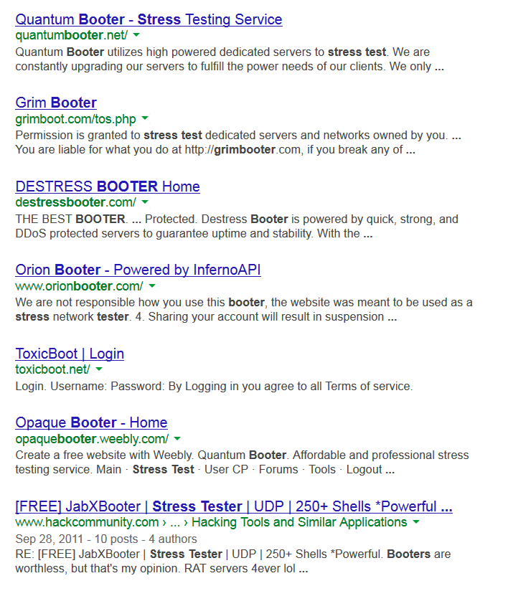

Slide 22
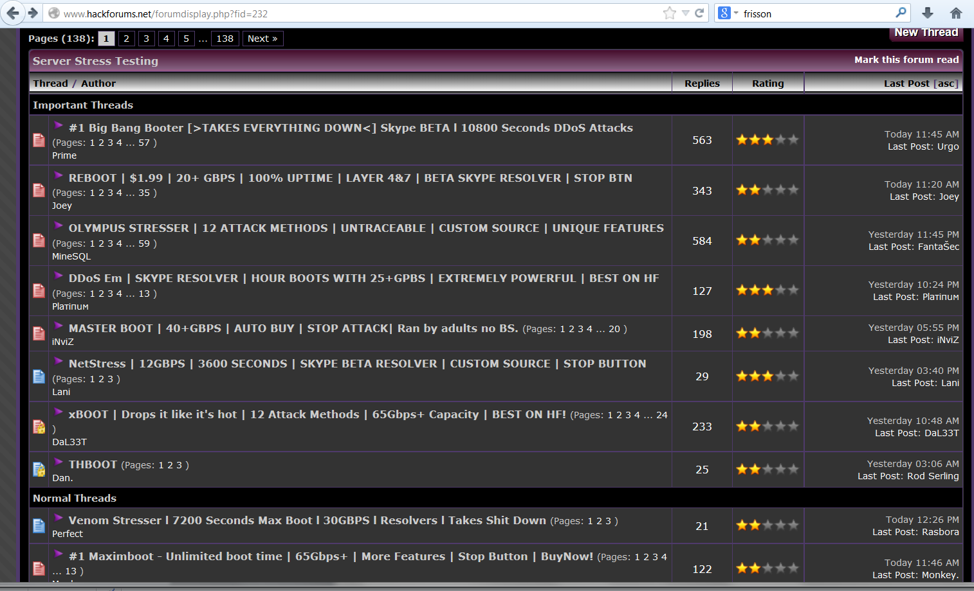

Slide 23
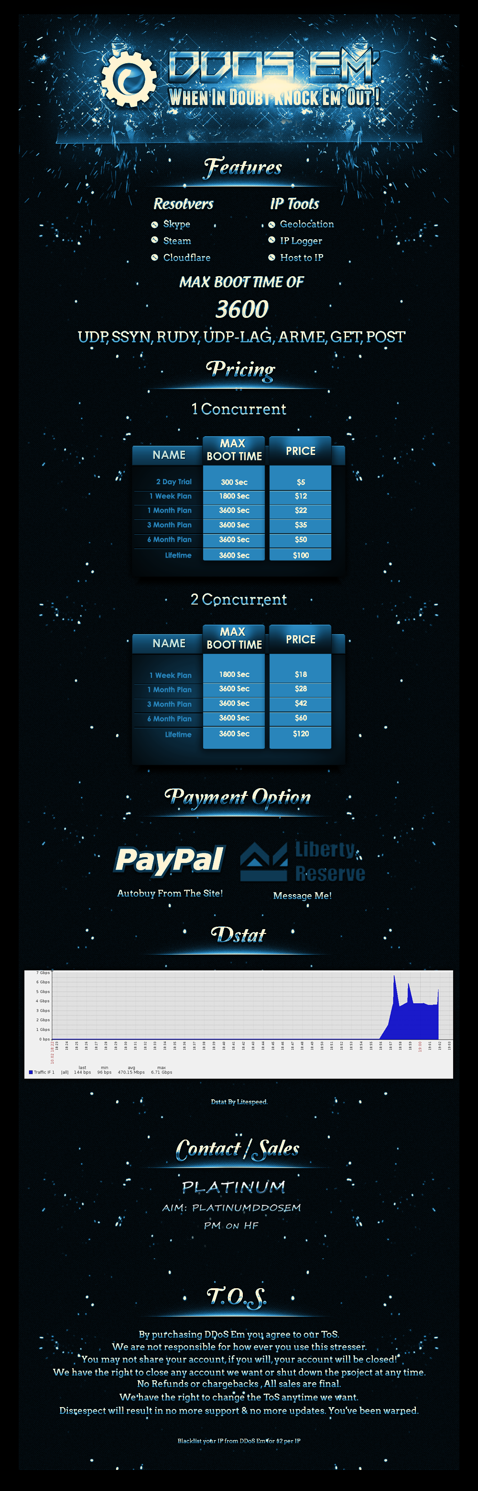

Slide 24
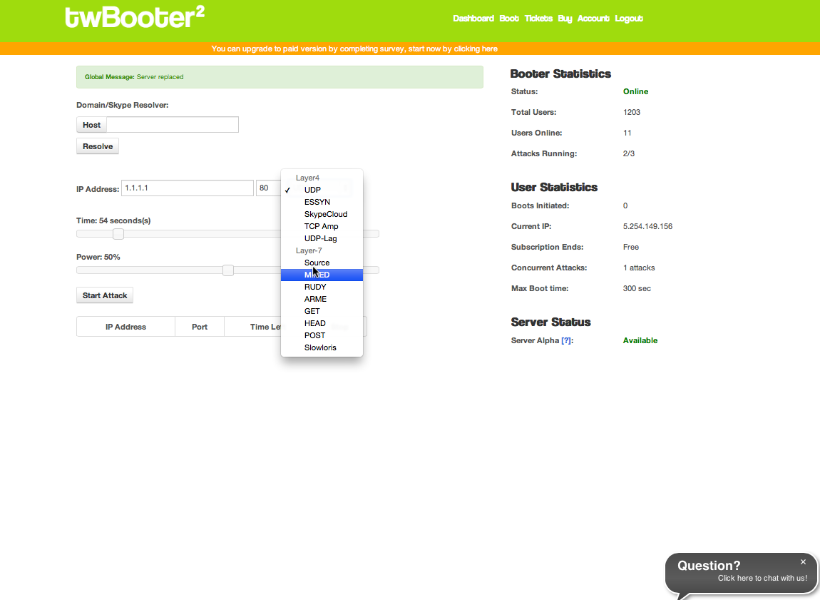

Slide 25
How to Setup Booter Service
Step 1: Website code
Asylumbooter source code is available at: http://softwaretopic.informer.com/asylum-booter-source/
Step 2: Attack Infrastructure
Rent or use compromised servers
Step 3: Establish payment via PayPal
Step 4: Advertise on Hackforums and Gamer sites
Step 5: Profit $$$

Slide 26
Dataset
Publicly post backend data from TWBooter2
Includes information on all attacks
IP/Domain targeted, type, duration, client
Confirmed details of attacks with one victim
Provides insight into infrastructure, users, and victims
Duration | Users | Victims | Attacks
Jan. 2013 - Mar. 2013 | 312 | 11,174 | 48,844

Slide 27

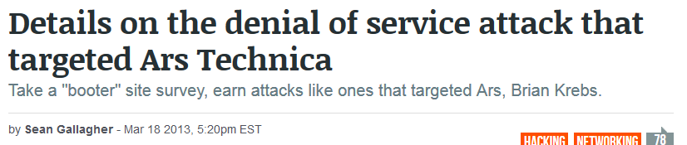
Used to Target Bloggers

Slide 28
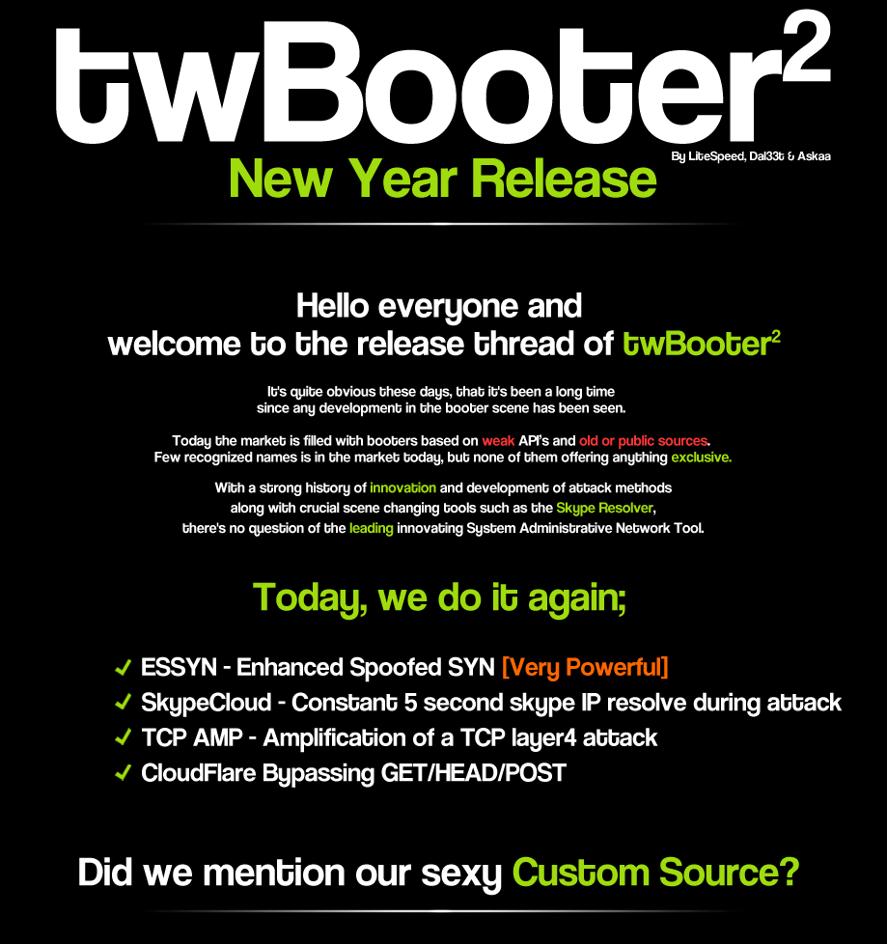
TWBooter Details
People
Askaa (Money)
DaL33t (Developer)
Both non-US citizens

Slide 29
Attack Infrastructure
15 servers total servers
3 active the entire two months
Most hosted at a Netherlands ISP
9 active at the time of data leak
Offered SYN flood, UDP flood and amplification attacks, HTTP-based attacks including HTTP POST/GET/HEAD and RUDY (R-U-Dead-Yet)

Slide 30
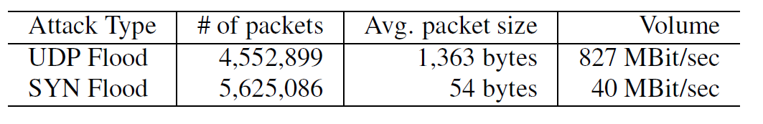
Attack Capacity
Subscribed to service to measure capacity.
SYN Floods spoof IP
UDP Flood uses DNS amplification
HTTP used 26,296 proxy servers over 5 mins
Some of these leaked original attack servers IPs

Slide 31
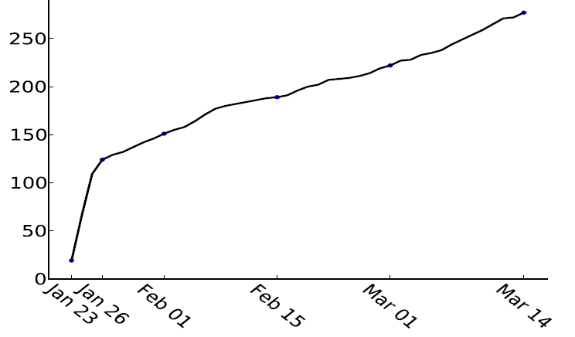
User Growth Rate
After initial burst growth rate of 3.2 Users

Slide 32
User Subscriptions
Categorized users based on subscription type
Gamers <= 10 Min attacks (65%)
Website >= 1 hour attacks (32%)
Privileged unlimited attacks (3%)
TwBooter earned $7,727/month based on subscription type

Slide 33
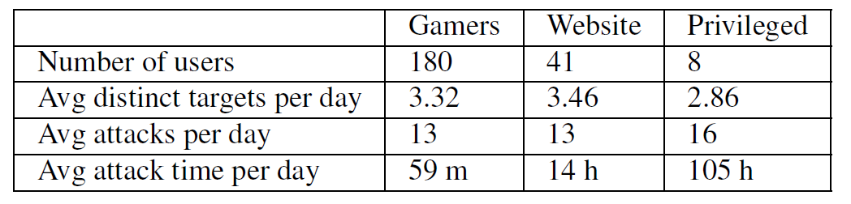
User Attacks
6 users are responsible for half (28,154 hours) of the attack time.

Slide 34

Victims
10,485 unique IP addresses attacked
689 identified as websites
Most are either game servers or game forums
Other booters and bloggers also targeted
Two users attacked government sites for 142 hours
Two Indian government
Los Angles police department

Slide 35

Other Booter Services
Leaks backend for Asylumbooter
Shows 5,622 subscribers
almost half a million attacks over 16 months
More backends can be found on pastebin
Show evidence of compromised servers used as attack infrastructure
Hacked into by “vigilante” groups, such as

Slide 36
Conclusion
Booters focused on low cost ($10-$200) and usability
Integrating features such as anti-cloudflare and Skype tracking
Uses effective DNS amplification attacks
TWBooter earned around $7,500/month

Slide 37


Understanding Booter Payment Processing
Mohammad Karami (GMU), Youngsam Park (UMD) and Damon McCoy (GMU)

Slide 38
Booters
Booters have become a commoditized service
Problem persists as long as they are profitable
Preserved low-risk activity
Understand payment level interventions

Slide 39


Booter Costs
Direct costs
Attack Server Hosting + Bandwidth
Payment Processing 2-3% + potentially seized funds
Indirect costs: Customer Support, IT costs, Advertising

Slide 40


Booter Payment Ecosystem
Pro: Accessible for US and EU customers
Con: Risk of account closure
Pro: Easy to accept and limited risk of seizure
Con: Difficult to for customers to buy into and use

Slide 41






Long Tail of Methods

Slide 42


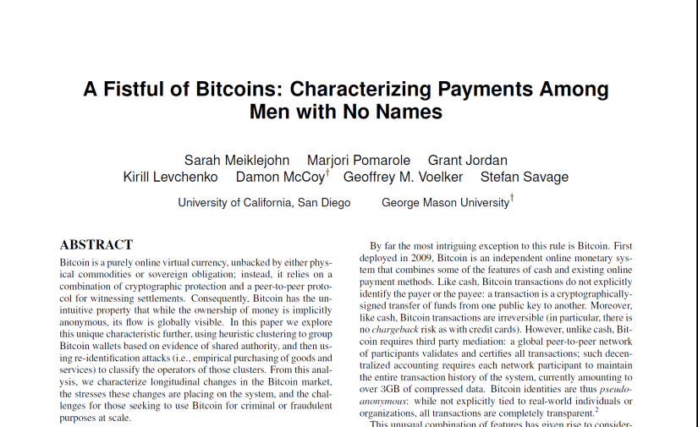
Bitcoin Payments
A large fraction of booters accept bitcoin
Some accept via third party payment service
Converts to fiat currency and deals with hassle
Risk of account closure
Some accept directly
Risk of tracing transactions
Tracing at exchange point

Slide 43
PayPal enforcement
Reported 56 booter services to PayPal
Created auto-purchasers to track new accounts and redirection domains
Enforcement based on referrer domain name
PayPal investigated and limited accounts
Effective, but there are limitations
Also reported to ISP hosting customer interface
Not effective

Slide 44
Aside on Website Hosting
Cloudflare hosted all the customer facing websites for the booters we monitored
No response from their abuse contact
Most domains registered with ENOM
Only response was from GoDaddy
They said the associated domain, quantumbooter.net, has already been reported
Domain is still active 3+ months later.

Slide 45
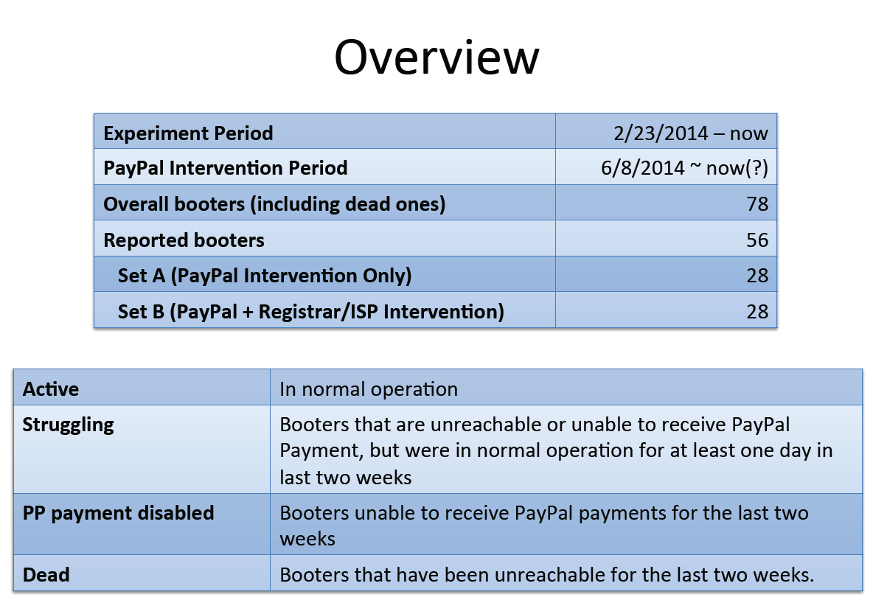
DataSet

Slide 46
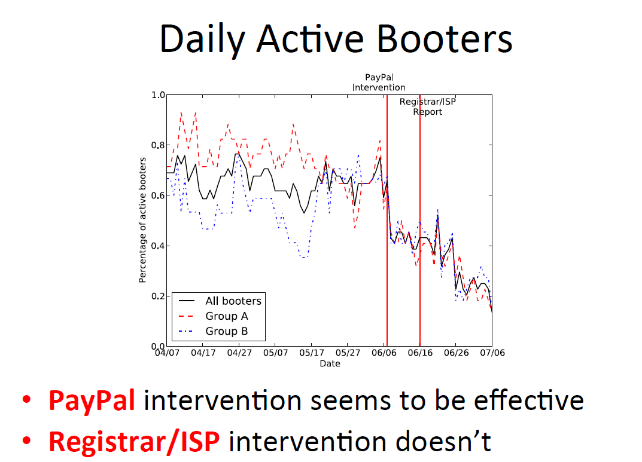
Results

Slide 47
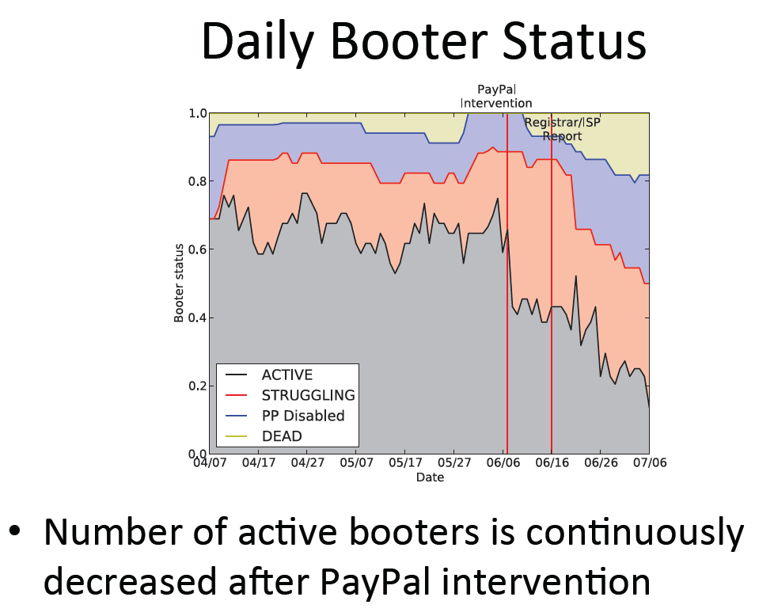

Slide 48
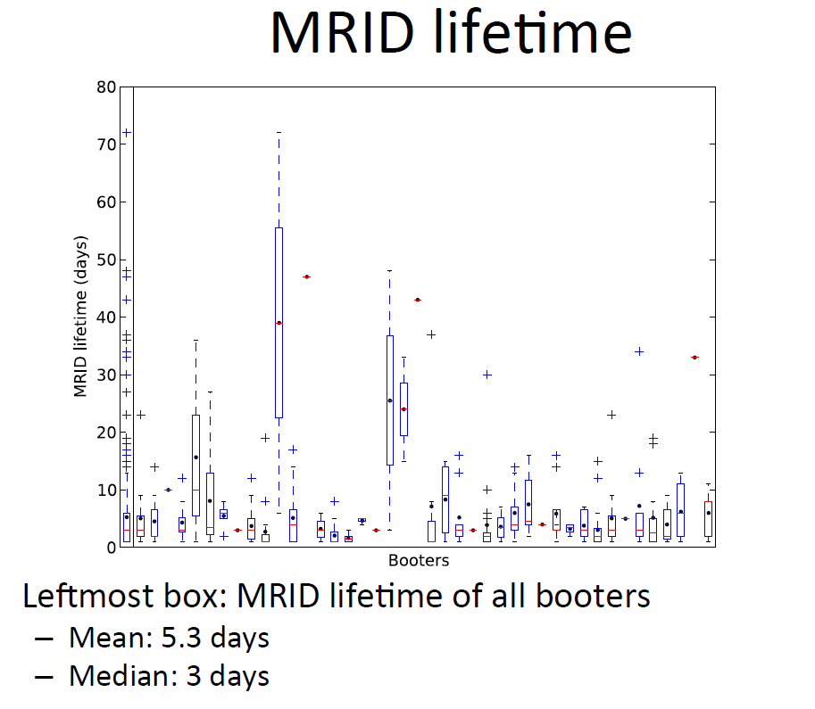

Slide 49
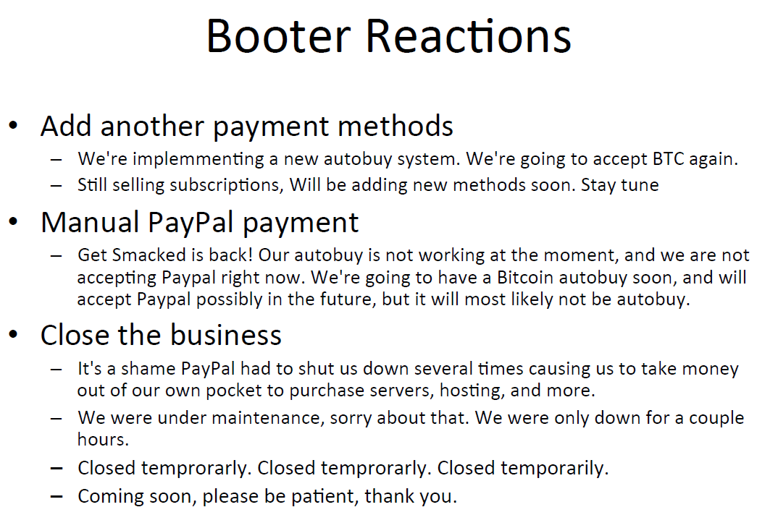

Slide 50
Evading PayPal Detection
Change Domain Name
Need to get updated domain name to customers and update ads
Add in redirection hop to hide real domain in referrer
Low-cost solution to avoid limiting from paypal
Traceable by automated purchaser

Slide 51
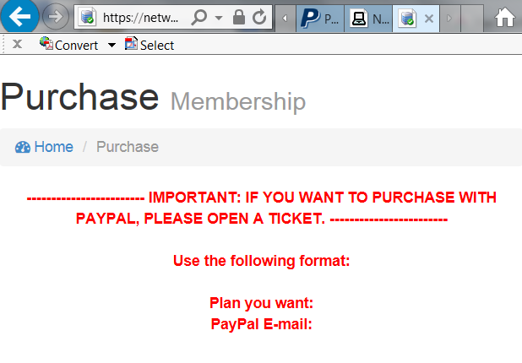
Evading PayPal Detection
Off-line acceptance of PayPal

Slide 52
Future Work
More sustained payment interventions
Reach out to other payment processors
Attempt to get aggregate information
Where are the customers from?
What is the volume of users?
What are the more heavily used ones?

Slide 53
Conclusions
Payment interventions are effective
More effective on smaller ones
Less effective on larger ones
Need to understand structure of booters
Difficult problem that requires collaboration

